Slide 1
Comparing Poverty Metrics
607 Final Project Presentation
Chad Bailey

Slide 2
Background
Poverty has a strong negative correlation with educational outcomes
Educational metrics of poverty focus on the rate of poverty but do not currently consider the magnitude/degree of poverty
Schools operate within a context of their communities

Slide 3
Project Plan
Acquire data educational data from the state of Michigan and community data from the US Census Bureau
Regress [Proficiency on State Assessments] against a metric of the rate of poverty
[Percent of Students in Poverty]
Regress [Proficiency on State Assessments] against a metric of the degree of poverty
[Median Household Income as a Percent of Poverty Threshold]
Examine the relationships and tensions between the two regressions

Slide 4
Data Sources
Data Type | Source
Proficiency on State Assessments | www.mischooldata.org / Data Request
School Demographic Information | www.mischooldata.org
Entity Data with both state and federal school codes | www.mi.gov / Data Request
Community Information from US Census API | https://api.census.gov/data.html
2016 US Poverty Thresholds | https://www.census.gov/library/publications/2017/demo/p60-259.html

Slide 5
Challenges & Work-Arounds
Issue | Resolution
Suppressions & Aggregations | Requested a data a file with fewer partitions
Non-published historical data | Requested a historical snapshot of data
Historical data filtered by current conditions | Small impact and so limitations were accepted
Scientific notation | Turned off with option(scipen = 999)
Loading excel files | Explored R packages but ended up converting to csv

Slide 6
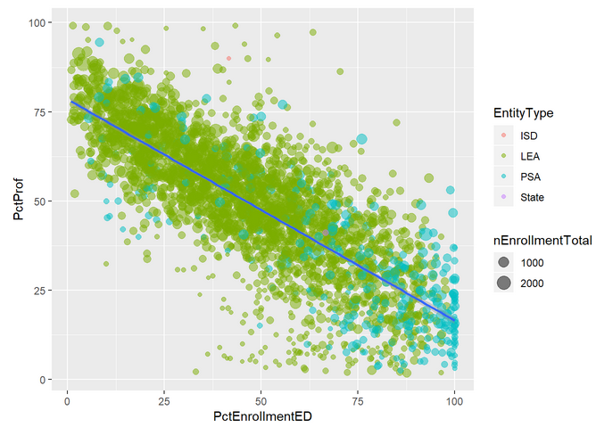
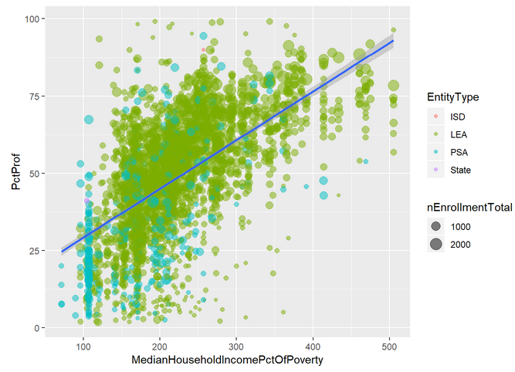
Regression Graphics
Poverty Rate Metric
Poverty Degree Metric

Slide 7
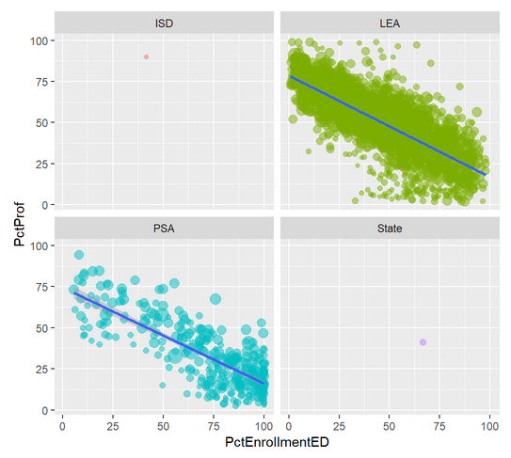
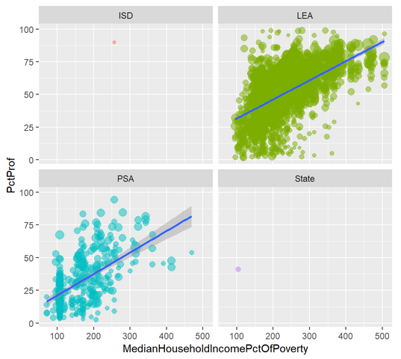
Regression Graphics by School Type
Poverty rate metric
Poverty degree metric

Slide 8
Results & Conclusions
Both poverty metrics have a visibly noticeable correlation with proficiency
Though as expected in opposite directions
The rate metric has a stronger correlation
Rate Adjusted R-Squared: 0.5997
Degree Adjusted R-Squared: 0.3345
The rate metric has a tighter correlation as shown in the following summary of residuals
Metric | Min | Q1 | Med | Q3 | Max
Rate | -55.773 | -6.964 | 0.550 | 7.455 | 58.071
Degree | -65.373 | -10.062 | 0.934 | 10.570 | 60.932

Slide 9
Possible Future Expansions
Also pull in US Census data on the rate of community poverty
This would allow for a more direct measure of the correlative differences between direct school measure and community measures
This would require additional data
Look for schools with very conflicting residuals between the two models
More closely tie community data to the school
Create a composite geographic district based on attending student residencies (as opposed to the current project’s use of school location)
This would require additional data

